Slide 1
Truncation errors: using Taylor series to approximation functions

Slide 2
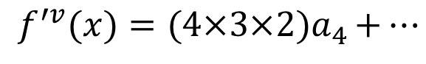
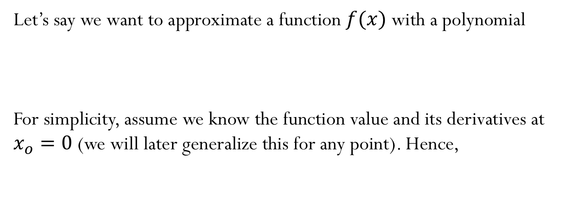

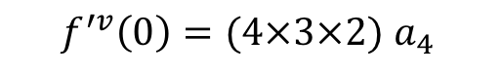



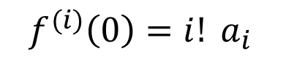
Approximating functions using polynomials:
Let’s say we want to approximate a function $f(x)$ with a polynomial
For simplicity, assume we know the function value and its derivatives at $x_{o}=0$ (we will later generalize this for any point). Hence,
$$f\left(x\right)=a_{o}+a_{1} x+ a_{2} x^{2}+a_{3} x^{3}+a_{4} x^{4}+⋯$$
$$f^{′}\left(x\right)=a_{1}+ {2 a}_{2} x+3 a_{3} x^{2}+4 a_{4} x^{3}+⋯$$
$$f^{′′}(x)={2 a}_{2}+ {\left(3×2\right)a}_{3 }x+{(4×3)a}_{4 }x^{2}+…$$
$$f^{′′′}(x)={\left(3×2\right)a}_{3 }+{(4×3×2)a}_{4 }x+…$$
$$f^{′v}(x)={(4×3×2)a}_{4 }+…$$
$$f\left(0\right)=a_{o}$$
$$f′′\left(0\right)={2 a}_{2}$$
$$f^{′v}\left(0\right)={(4×3×2) a}_{4 }$$
$$f^{(i)}\left(0\right)={i! a}_{i }$$
$$f′\left(0\right)=a_{1}$$
$$f′′′\left(0\right)={(3×2) a}_{3 }$$

Slide 3
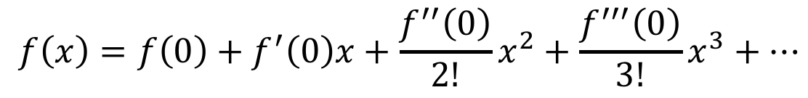
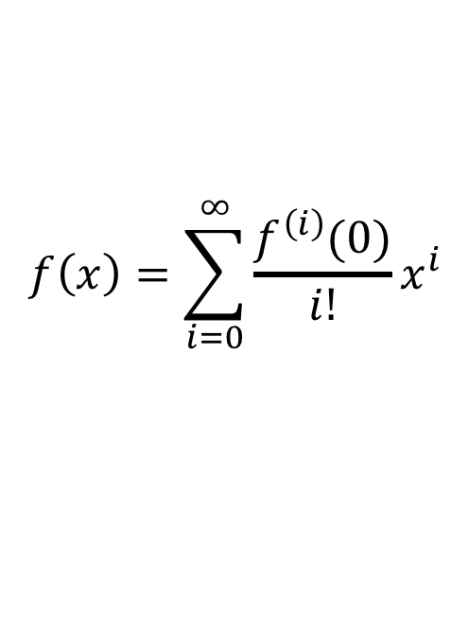
Taylor Series
Taylor Series approximation about point $x_{o}=0$
$$f\left(x\right)=a_{o}+a_{1} x+ a_{2} x^{2}+a_{3} x^{3}+a_{4} x^{4}+⋯$$
$$f\left(x\right)=f\left(0\right)+f^{′}\left(0\right)x+\frac{f^{′′}\left(0\right)}{2!}x^{2}+\frac{f^{′′′}\left(0\right)}{3!}x^{3}+⋯$$
$$f\left(x\right)=\sum_{i=0}^{∞}{\frac{f^{\left(i\right)}(0)}{i!}x^{i}}$$
Demo “Polynomial Approximation with Derivatives” – Part 1

Slide 4
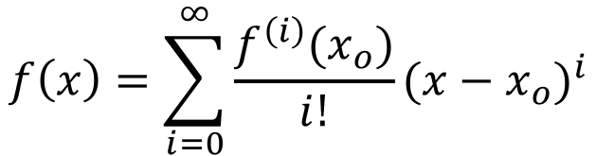
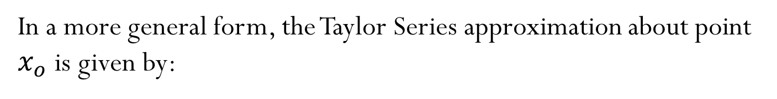
Taylor Series
In a more general form, the Taylor Series approximation about point $x_{o}$ is given by:
$$f\left(x\right)=f\left(x_{o}\right)+f^{′}\left(x_{o}\right)(x−x_{o})+\frac{f^{′′}\left(x_{o}\right)}{2!}{(x−x_{o})}^{2}+\frac{f^{′′′}\left(x_{o}\right)}{3!}{(x−x_{o})}^{3}+⋯$$
$$f\left(x\right)=\sum_{i=0}^{∞}{\frac{f^{\left(i\right)}(x_{o})}{i!}{(x−x_{o})}^{i}}$$

Slide 5
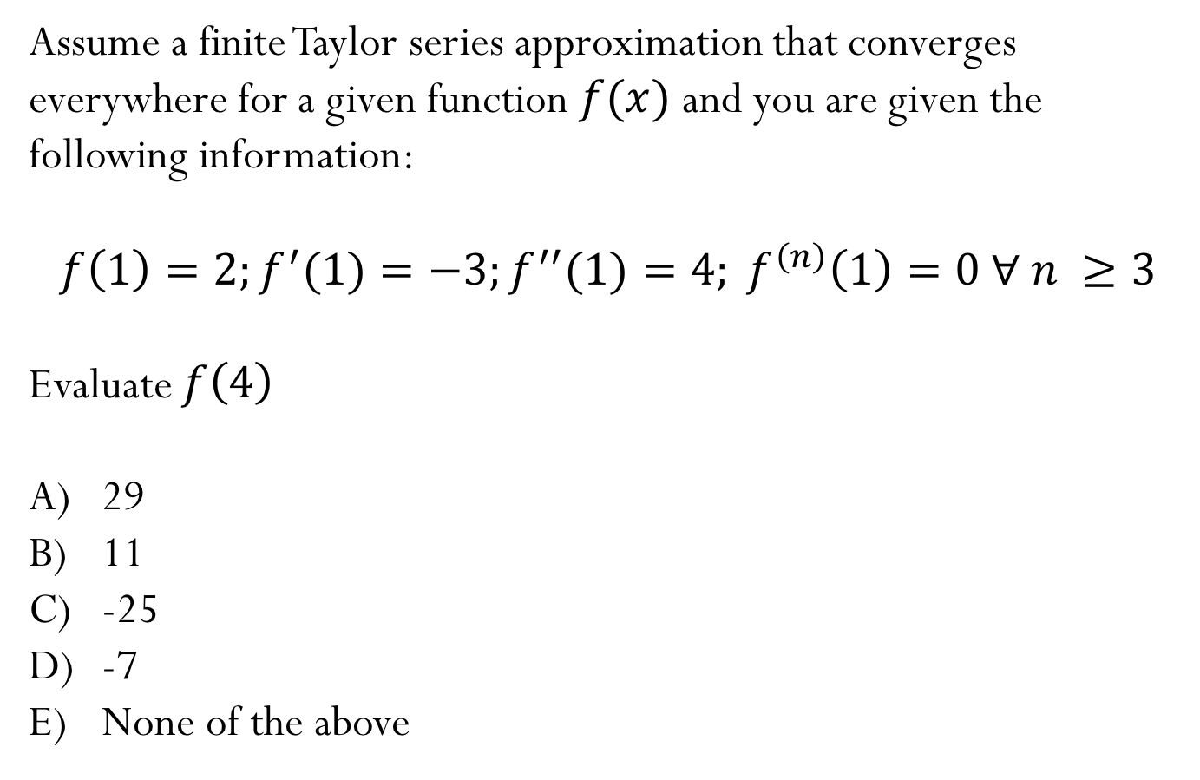
Iclicker question
Assume a finite Taylor series approximation that converges everywhere for a given function $f(x)$ and you are given the following information:
$$f\left(1\right)=2;f^{′}(1)=−3;f^{′′}(1)=4; f^{\left(n\right)}\left(1\right)=0 ∀ n ≥3$$
Evaluate $f\left(4\right)$
29
11
-25
-7
None of the above

Slide 6
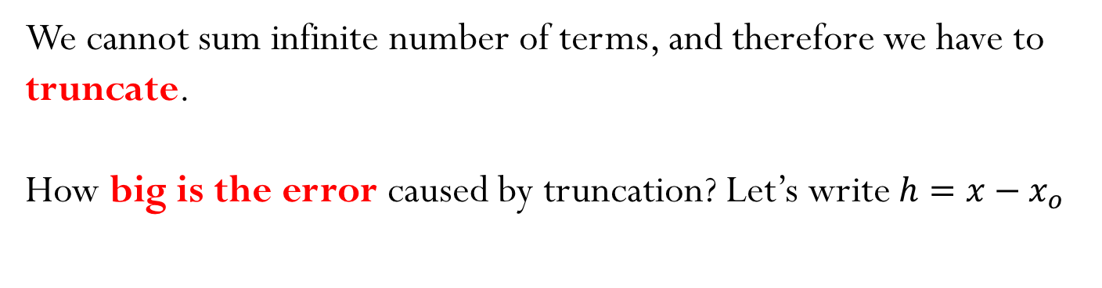
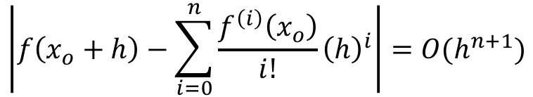

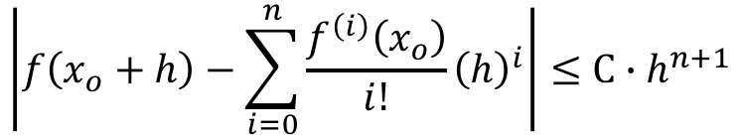
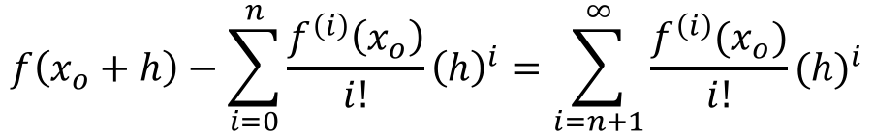
Taylor Series
Demo “Polynomial Approximation with Derivatives” – Part 2
We cannot sum infinite number of terms, and therefore we have to truncate.
How big is the error caused by truncation? Let’s write$h=x−x_{o}$
$$f\left(x_{o}+h\right)−\sum_{i=0}^{n}{\frac{f^{\left(i\right)}\left(x_{o}\right)}{i!}{\left(h\right)}^{i}=\sum_{i=n+1}^{∞}{\frac{f^{\left(i\right)}(x_{o})}{i!}{(h)}^{i}}}$$
And as $h→0$ we write:
$$\left|f\left(x_{o}+h\right)−\sum_{i=0}^{n}{\frac{f^{\left(i\right)}\left(x_{o}\right)}{i!}{\left(h\right)}^{i}}\right|≤C∙h^{n+1}$$
Error due to Taylor approximation of degree n
$$\left|f\left(x_{o}+h\right)−\sum_{i=0}^{n}{\frac{f^{\left(i\right)}\left(x_{o}\right)}{i!}{\left(h\right)}^{i}}\right|=O(h^{n+1})$$

Slide 7
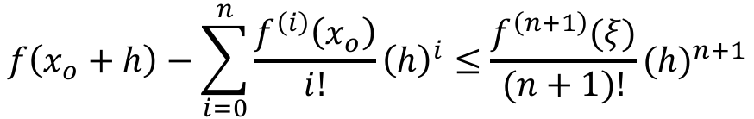
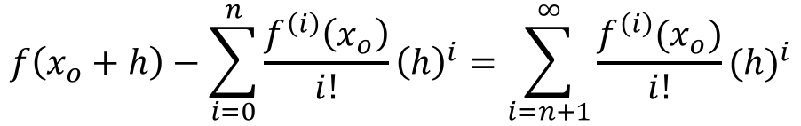
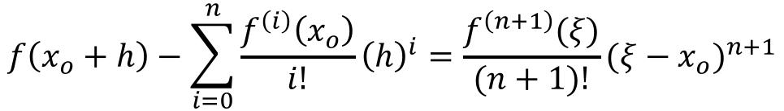
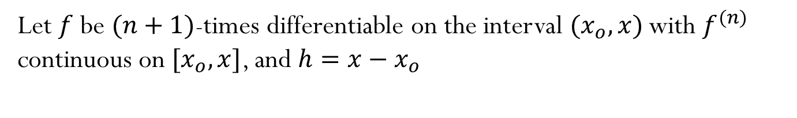
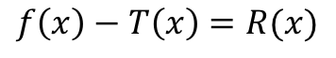
Taylor series with remainder
Let $f$ be $(n+1)$-times differentiable on the interval ${(x}_{o},x)$ with $f^{(n)}$ continuous on ${[x}_{o},x]$, and $h=x−x_{o}$
$$f\left(x_{o}+h\right)−\sum_{i=0}^{n}{\frac{f^{\left(i\right)}\left(x_{o}\right)}{i!}{\left(h\right)}^{i}=\sum_{i=n+1}^{∞}{\frac{f^{\left(i\right)}(x_{o})}{i!}{(h)}^{i}}}$$
Then there exists a ${ξ∈(x}_{o},x)$ so that
$$f\left(x_{o}+h\right)−\sum_{i=0}^{n}{\frac{f^{\left(i\right)}\left(x_{o}\right)}{i!}{\left(h\right)}^{i}=\frac{f^{\left(n+1\right)}(ξ)}{(n+1)!}{(ξ−x_{o})}^{n+1}}$$
$$f\left(x\right)−T\left(x\right)=R(x)$$
And since $\left|ξ−x_{o}\right|≤h$
Taylor remainder
$$f\left(x_{o}+h\right)−\sum_{i=0}^{n}{\frac{f^{\left(i\right)}\left(x_{o}\right)}{i!}{\left(h\right)}^{i}≤\frac{f^{\left(n+1\right)}(ξ)}{(n+1)!}{(h)}^{n+1}}$$

Slide 8
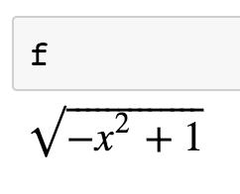
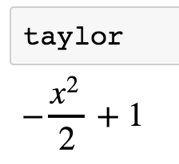

Demo: Polynomial Approximation with Derivatives

Slide 9
Demo: Polynomial Approximation with Derivatives

Slide 10
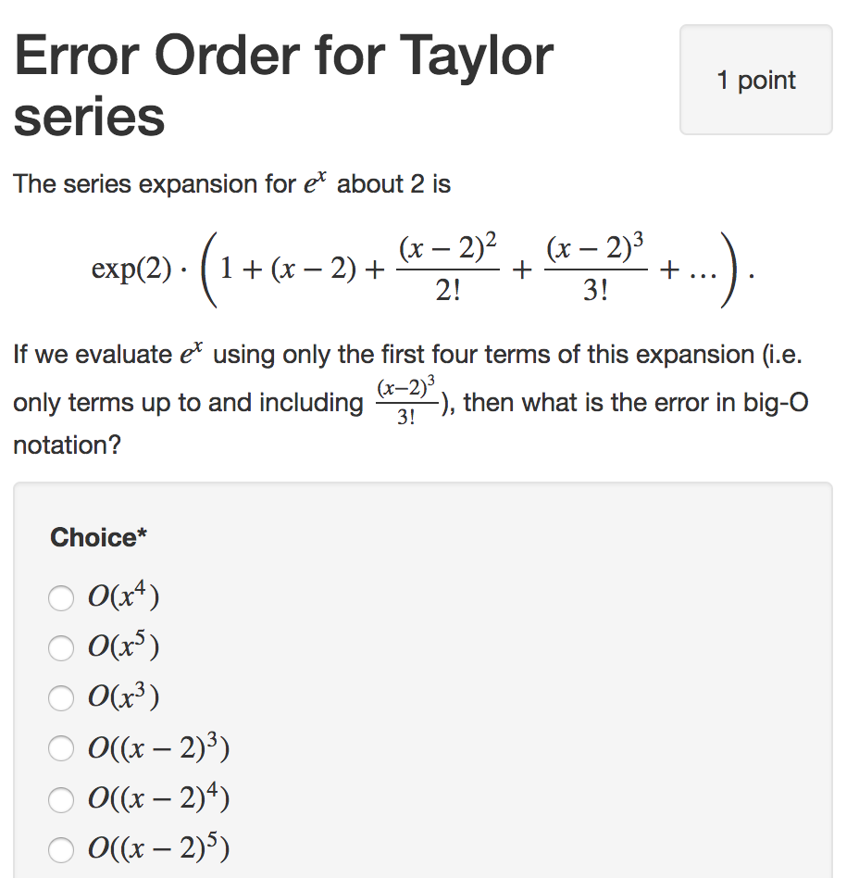
Iclicker question
A)
B)
C)
D)
E)
Demo “Taylor of exp(x) about 2”

Slide 11
Making error predictions
Demo “Polynomial Approximation with Derivatives” – Part 3

Slide 12
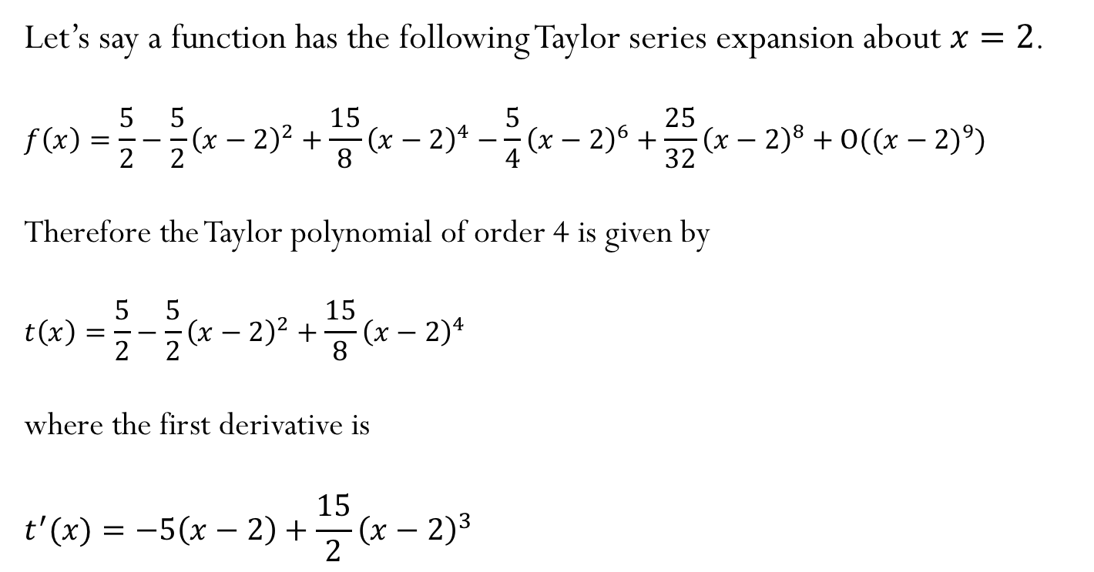
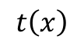
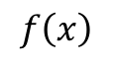
Using Taylor approximations to obtain derivatives
Let’s say a function has the following Taylor series expansion about $x=2$.
$$f\left(x\right)=\frac{5}{2}−\frac{5}{2}{\left(x−2\right)}^{2}+\frac{15}{8}{\left(x−2\right)}^{4}−\frac{5}{4}{\left(x−2\right)}^{6}+\frac{25}{32}{\left(x−2\right)}^{8}+O(({x−2)}^{9})$$
Therefore the Taylor polynomial of order 4 is given by
$$t\left(x\right)=\frac{5}{2}−\frac{5}{2}{\left(x−2\right)}^{2}+\frac{15}{8}{\left(x−2\right)}^{4}$$
where the first derivative is
$$t^{′}(x)=−5\left(x−2\right)+\frac{15}{2}{\left(x−2\right)}^{3}$$
$$t\left(x\right)$$
$$f\left(x\right)$$

Slide 13
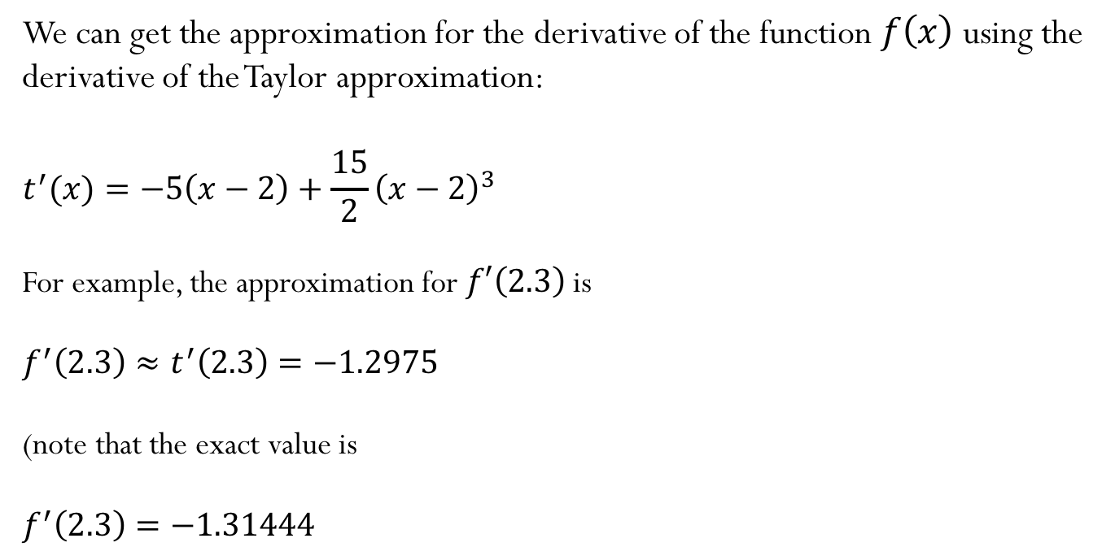

Using Taylor approximations to obtain derivatives
We can get the approximation for the derivative of the function $f\left(x\right)$ using the derivative of the Taylor approximation:
$$t^{′}(x)=−5\left(x−2\right)+\frac{15}{2}{\left(x−2\right)}^{3}$$
For example, the approximation for $f′\left(2.3\right)$ is
$$f^{′}\left(2.3\right)≈t^{′}\left(2.3\right)=−1.2975$$
(note that the exact value is
$$f^{′}\left(2.3\right)=−1.31444$$
$$t\left(x\right)$$
What happens if we want to use the same method to approximate $f′\left(3\right)$ ?
$$f\left(x\right)$$

Slide 14
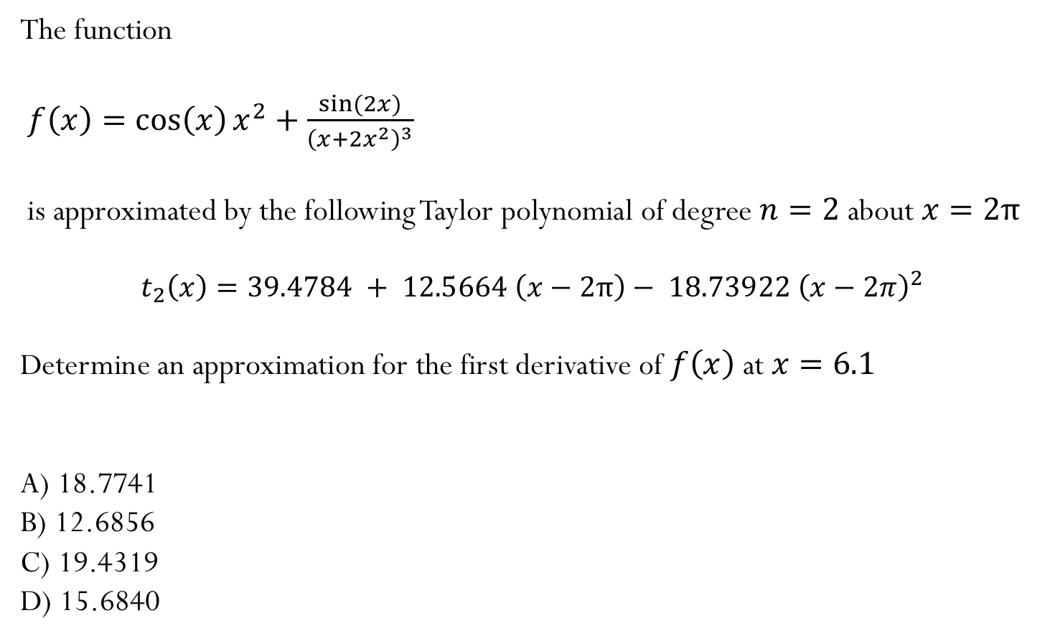
Iclicker question
The function
$f\left(x\right)=\cos\left(x\right)x^{2}+\frac{sin⁡(2x)}{{\left(x+2x^{2}\right)}^{3}}$
is approximated by the following Taylor polynomial of degree $n=2$ about $x=2π$
$$t_{2}\left(x\right)=39.4784 + 12.5664 \left(x−2π\right)− 18.73922{ \left(x−2π\right)}^{2}$$
Determine an approximation for the first derivative of $f\left(x\right)$ at $x=6.1$
A) 18.7741
B) 12.6856
C) 19.4319
D) 15.6840
Notes:
Answer is C

Slide 15
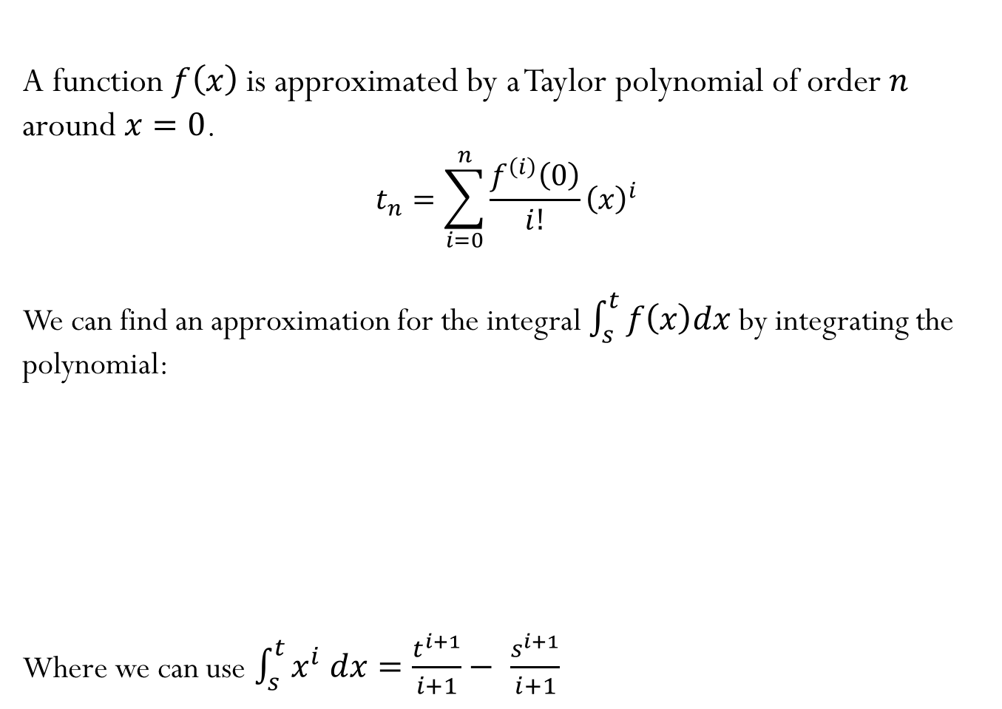
Computing integrals using Taylor Series
A function $f\left(x\right)$is approximated by a Taylor polynomial of order$n$ around $x=0$.
$$t_{n}=\sum_{i=0}^{n}{\frac{f^{\left(i\right)}\left(0\right)}{i!}{\left(x\right)}^{i}}$$
We can find an approximation for the integral $\int_{s}^{t}{f\left(x\right)dx}$ by integrating the polynomial:
Where we can use $\int_{s}^{t}{x^{i} dx}=\frac{t^{i+1}}{i+1}−$ $\frac{s^{i+1}}{i+1}$
Demo “Computing PI with Taylor”

Slide 16
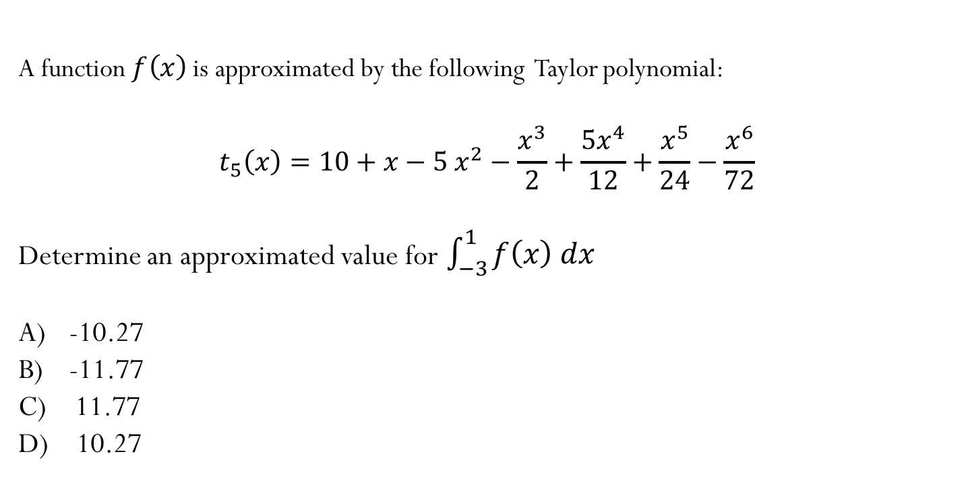
Iclicker question
A function $f\left(x\right)$is approximated by the following Taylor polynomial:
$$t_{5}\left(x\right)=10+x−5 x^{2}−\frac{x^{3}}{2}+\frac{{5x}^{4}}{12}+\frac{x^{5}}{24}−\frac{x^{6}}{72}$$
Determine an approximated value for $\int_{−3}^{1}{f\left(x\right) dx}$
-10.27
-11.77
C) 11.77
D) 10.27

